Slide 1


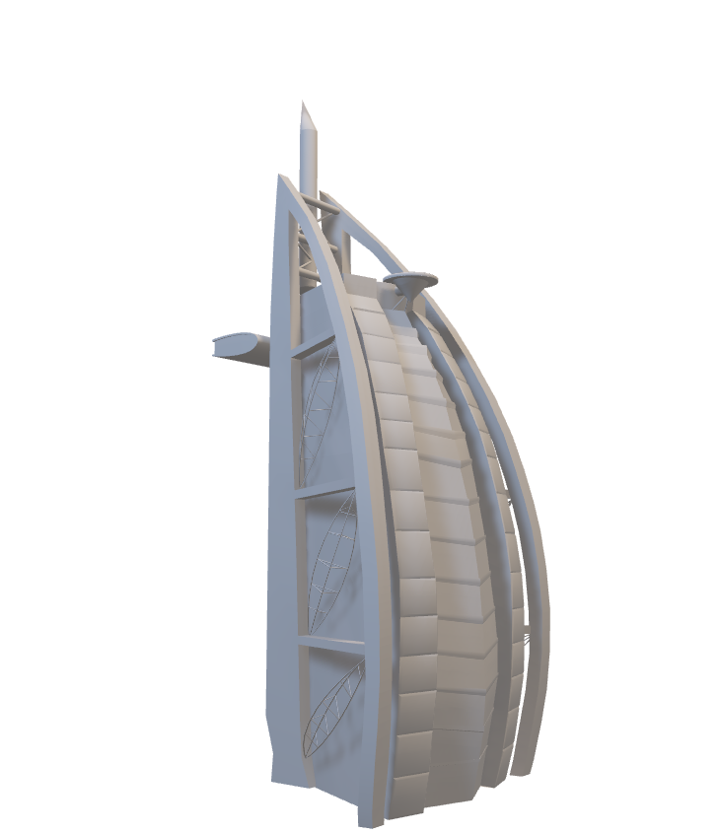
AtliQ Hotels 🏨
Data Analysis 📊
Group – 5
Kampally Sai Pavan Kumar
Nandyala Vedha Kalyan
Rahul Kamlesh Kumar Jaiswar
Tanikonda Laxman Teja
Wilson Luies Telore
Khandesh Sri Narasimha

Slide 2



Project Overview 🎯– AtliQ Hotels
The Atiq Hotels project presents a comprehensive performance review of key hospitality metrics across multiple hotel branches. The aim is to gain actionable insights into guest behavior, room utilization, revenue optimization, and booking trends.
Tools Used:
Excel: For data wrangling, calculations, and static dashboards
Power BI: For dynamic KPI tracking with slicers & filters
Tableau: For storytelling visualizations and deep-dive trend analysis
SQL: For structured query-based exploration of performance KPIs

Slide 3


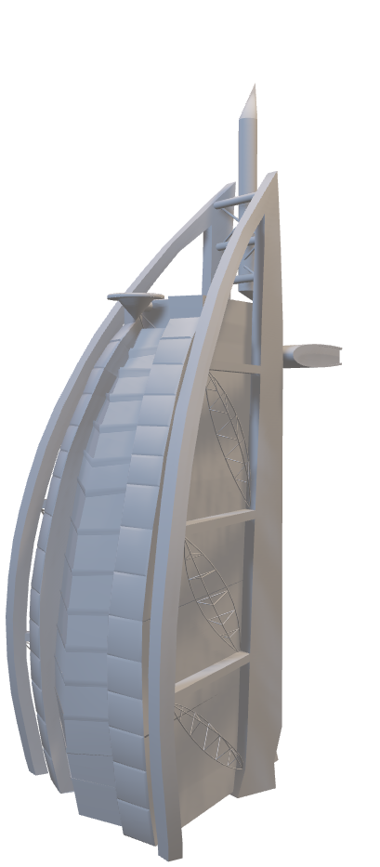
📝Objectives – AtliQ Hotels
🎯 Understand performance across hotel categories and geographies 🎯 Evaluate guest behaviour patterns across weekdays vs weekends 🎯 Measure occupancy, booking trends, and cancellation rates 🎯 Track revenue, room utilization, and platform-based booking insights 🎯 Build interactive dashboards for management review

Slide 4

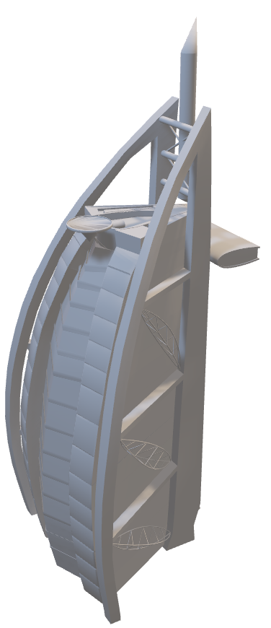
🧪 Methodology – AtliQ Hotels
📘 Excel: Extracted KPIs from fact tables Built pivot tables & static dashboards
🟨 SQL: Generated insights via queries using joins and conditions Created calculated columns for occupancy, revenue, booking status, etc.
🟥 Power BI: Built dynamic dashboards using DAX Enabled filtering by hotel, city, room type, time period
🟪 Tableau: Created interactive dashboards with advanced filter logic Visualized trends in booking types, guest behaviour, revenue, and occupancy

Slide 5



📌 KPIs Tracked – AtliQ Hotels
✅ Total Revenue
✅ Occupancy Rate
✅ Cancellation Rate
✅ Total Bookings
✅ Utilized Capacity %
✅ Weekday vs Weekend Analysis
✅ Revenue by State
✅ Class-wise Revenue
✅ Booking Status Trends (Checked Out / Cancel / No-show)
✅ Booking Source Trends
✅ Monthly & Weekly Trend Analysis

Slide 6

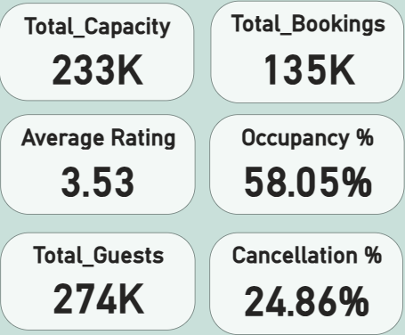
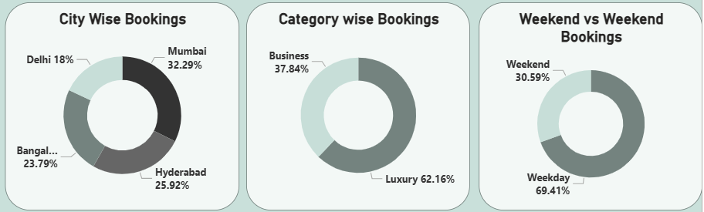

Key Booking Insights – Volume, Ratings & Trends
:🛏️ Occupancy Rate stands at 58.05%, indicating growth potential in room utilization.
🚫 Cancellation Rate is high at 24.86% — a key area to address for revenue retention.
🌟 Average Rating of 3.53/5 shows moderate guest satisfaction.
🏙️ Mumbai leads in bookings (32.29%), followed by Hyderabad and Bangalore.
💎 Luxury hotels dominate with 62.16% of total bookings.
📅 Weekday bookings make up 69.41%, driven by business travelers.

Slide 7

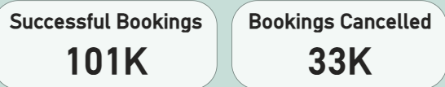
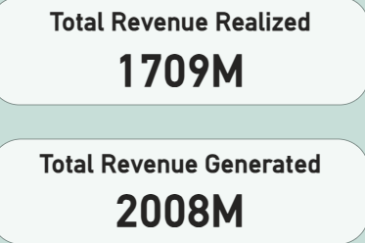
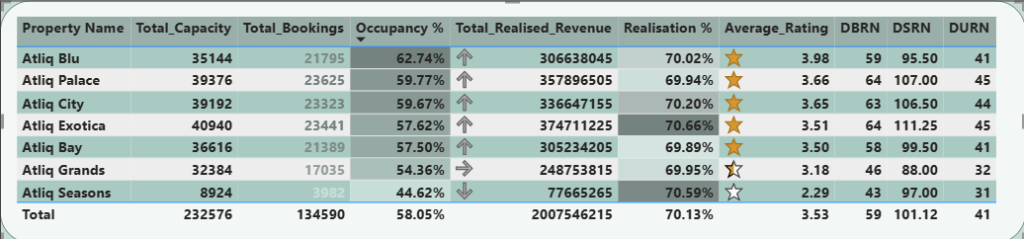
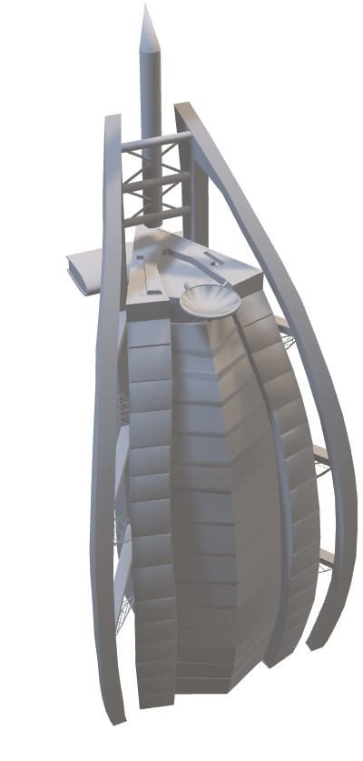
📈 Property-Wise Performance – Occupancy, Revenue & Ratings
✅ 101K bookings completed vs 33K cancellations – ~25% drop-off
💰 Revenue Realized: 1709M out of 2008M generated → ~85% realization
📊 Top performer: Atliq Blu with 62.7% occupancy & 3.98
⭐ rating
📉 Lowest performer: Atliq Seasons – only 44.6% occupancy & 2.29⭐ rating

Slide 8
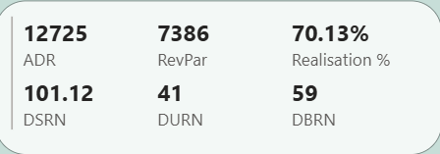
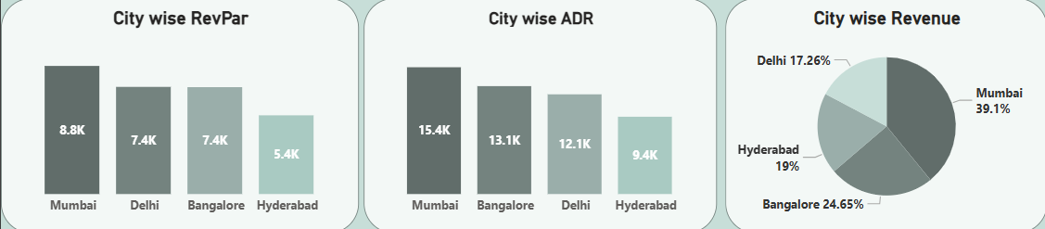
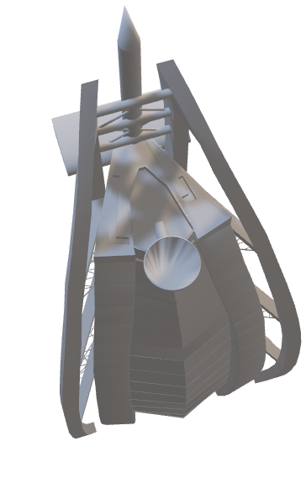
🏙️ City-Level Performance – ADR, RevPar & Revenue Share
💸 Mumbai leads with the highest ADR (₹15.4K) and RevPar (₹8.8K) — top revenue contributor at 39.1%
📊 Bangalore shows a strong 24.65% revenue share, despite similar ADR to Delhi
📉 Hyderabad underperforms with the lowest ADR (₹9.4K) and RevPar (₹5.4K)
📈 Overall Realisation: 70.13%
→ Key conversion metrics:
ADR: ₹12,725 | RevPar: ₹7,386 | DBRN: 59 | DSRN: 101.12 | DURN: 41

Slide 9
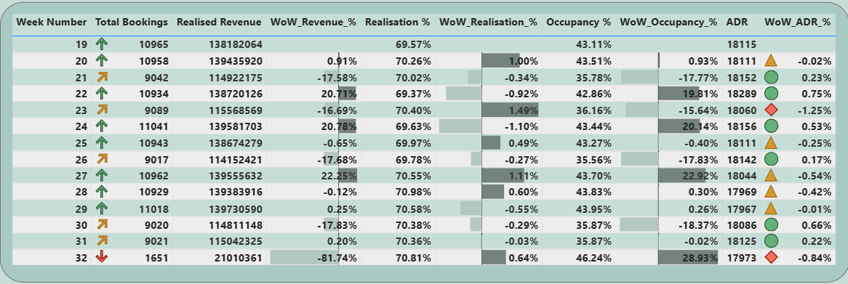
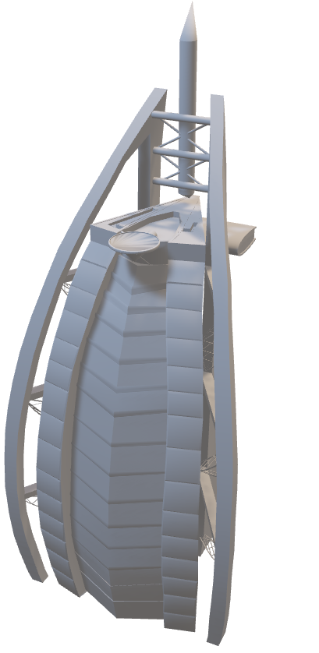
📅 WoW Trends – Revenue, Occupancy & ADR Insights
📈 Stable Realisation: Realisation % stayed consistent around 70–71% across weeks
🔻 Week 32 saw a major drop in bookings (1,651) and revenue (−81.74% WoW)
🚀 Week 27 was a standout with:Highest occupancy growth: +22.92%ADR: ₹18,044
⚠️ ADR fluctuations remained minor, mostly within ±1%, showing price stability
📉 Notable weekly dips in Week 21 & 26, driven by revenue and occupancy slumps

Slide 10




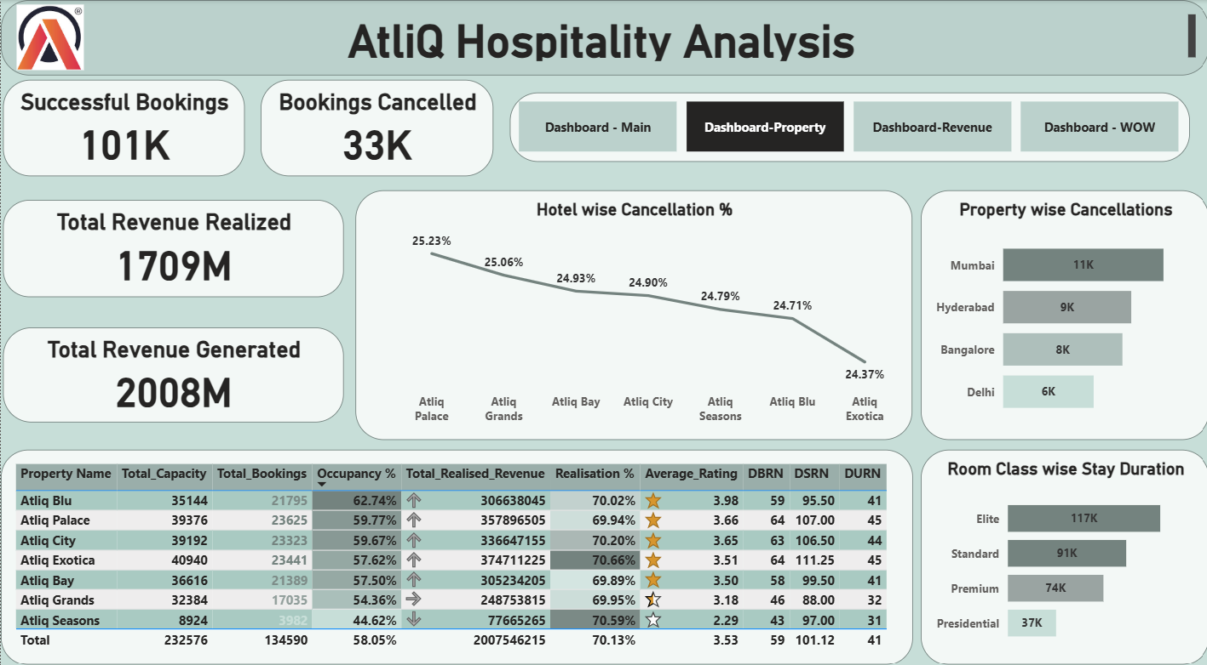
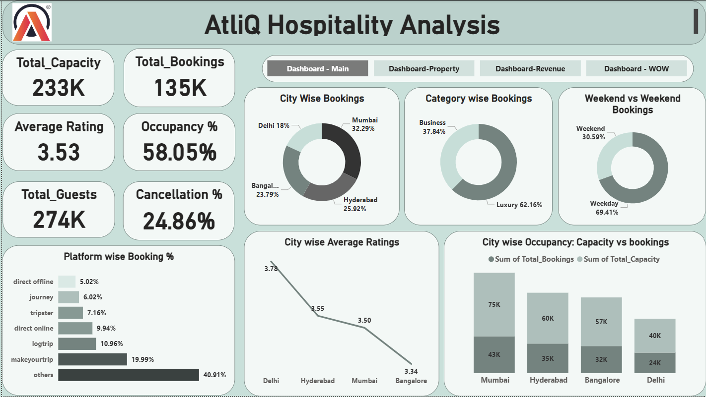
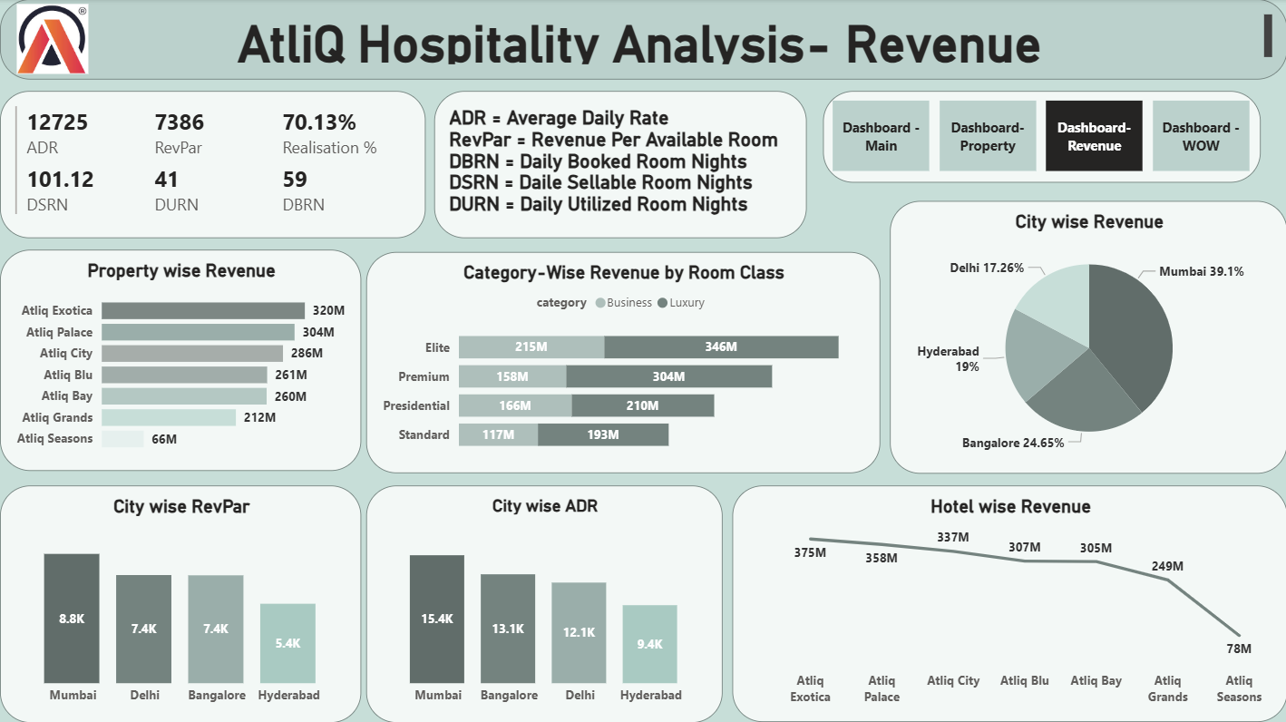
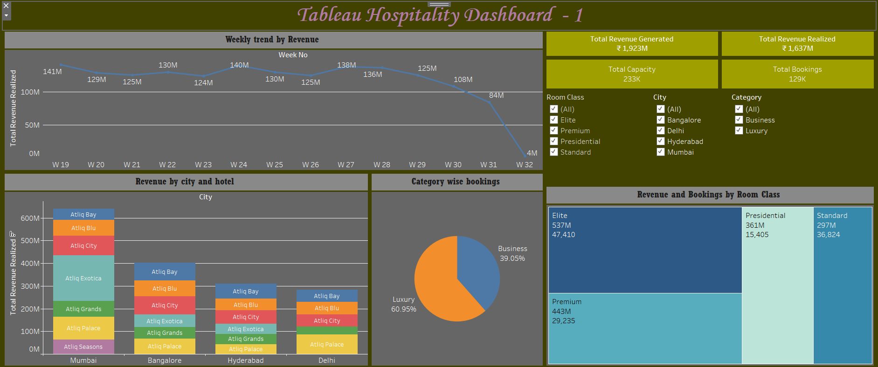
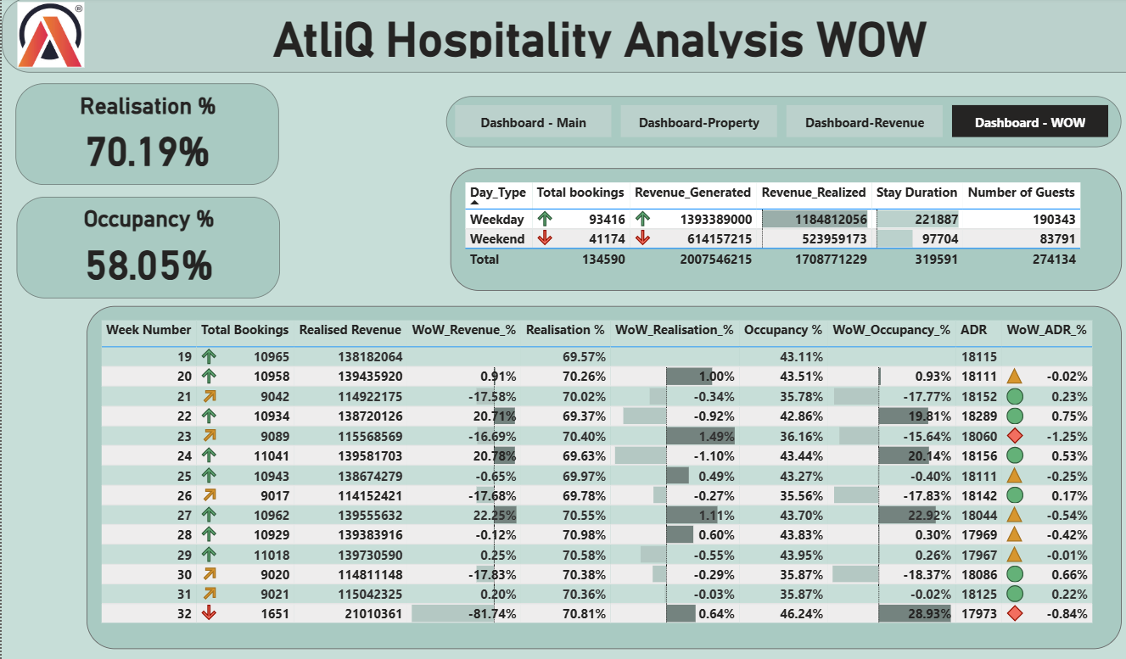
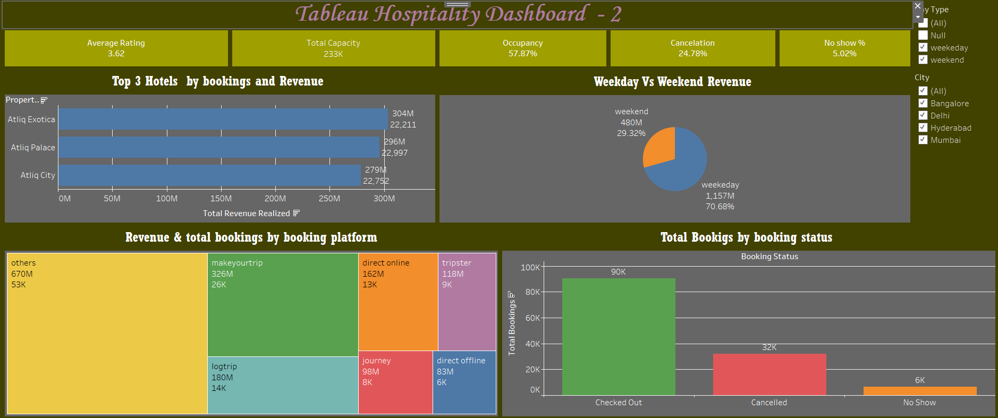
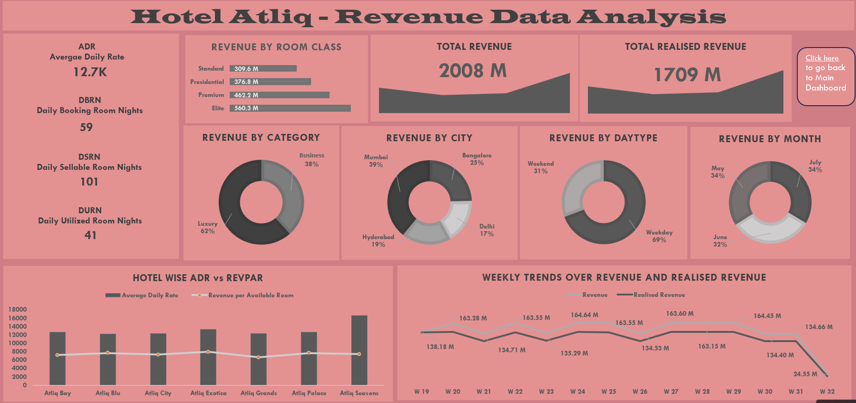
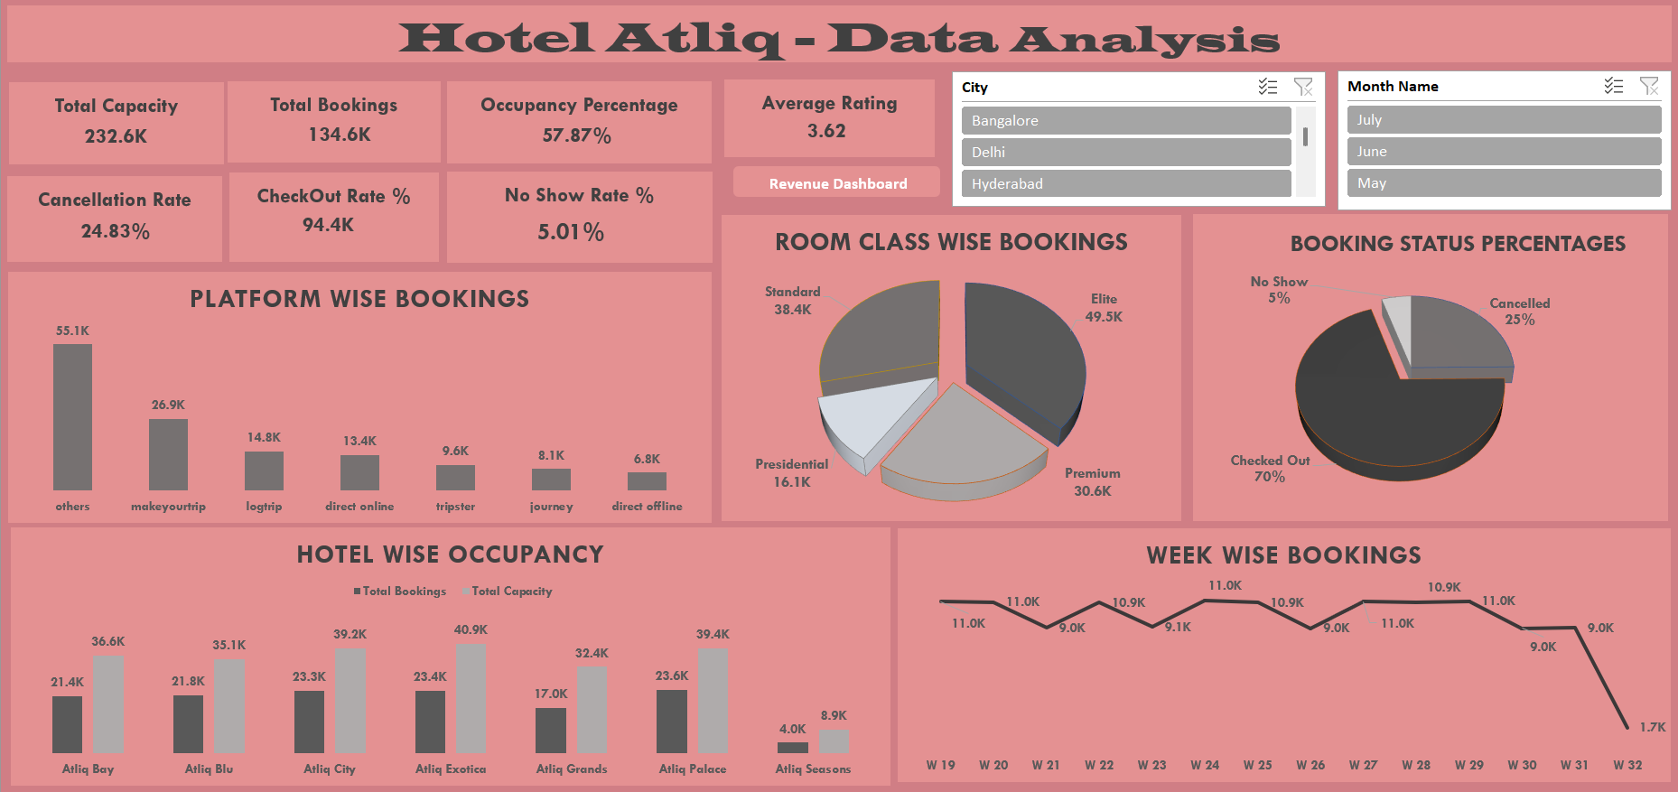

📊Dashboard Summary Tool Comparisons
Excel Dashboard
Power BI Dashboard
Tableau Dashboard
Simple layout for static review
Slicers for hotel, city, date
KPI cards: Occupancy, revenue, booking source
Dynamic charts: Revenue vs Cancel Rate, ADR trend, booking platform filter
Interactive filters: Date, Room Type, City Storyboard showing Booking Status, Occupancy, and Class-wise Revenue

Slide 11

Excel Dashboard - 1
Power BI Dashboard
Tableau Dashboard

Slide 12
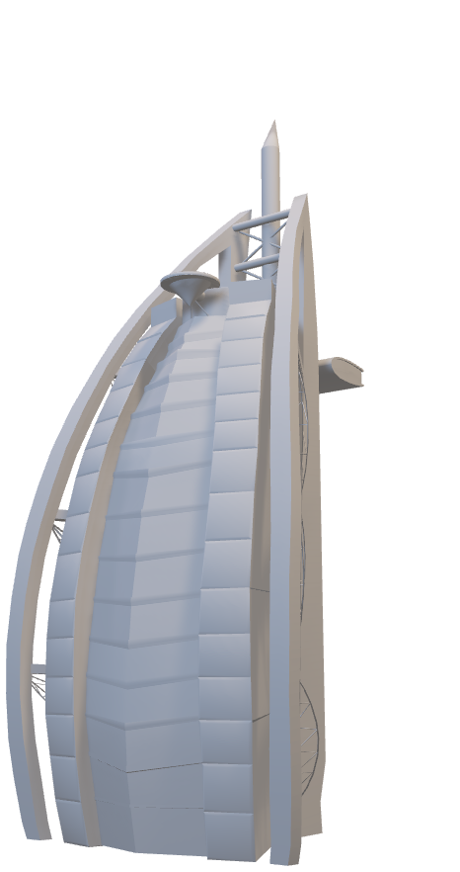
Excel Dashboard - 2
Power BI Dashboard
Tableau Dashboard

Slide 13

Power BI Dashboard - 1
Tableau Dashboard
Excel Dashboard - 2

Slide 14

Power BI Dashboard - 2
Tableau Dashboard
Excel Dashboard - 2

Slide 15

Power BI Dashboard - 3
Tableau Dashboard
Excel Dashboard - 2

Slide 16

Power BI Dashboard - 4
Tableau Dashboard
Excel Dashboard - 2

Slide 17

Tableau Dashboard - 1
Excel Dashboard - 2
Power BI Dashboard - 4

Slide 18

Tableau Dashboard - 2
Excel Dashboard - 2
Power BI Dashboard - 4

Slide 19

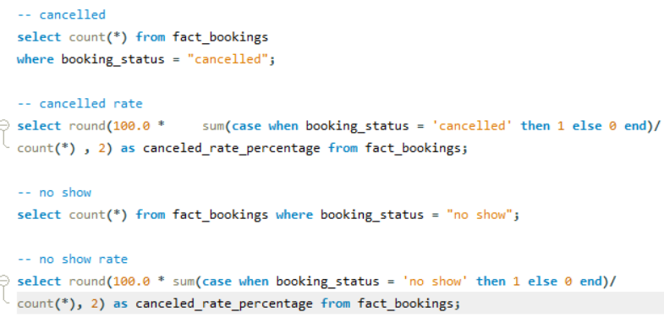
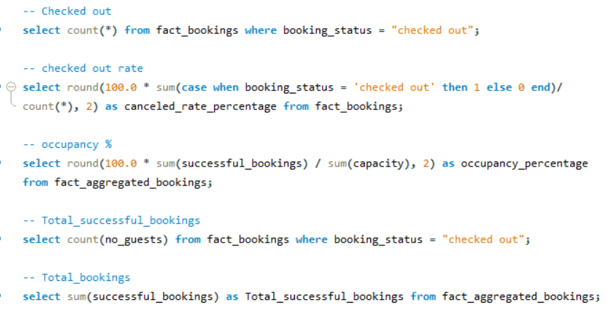
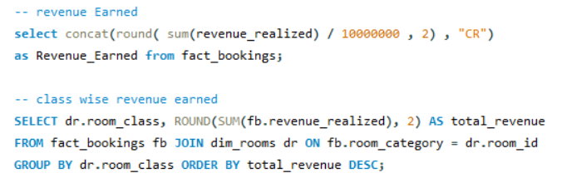
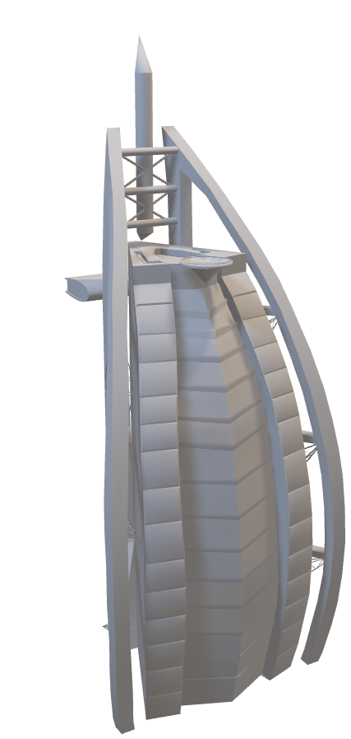
SQL Queries

Slide 20

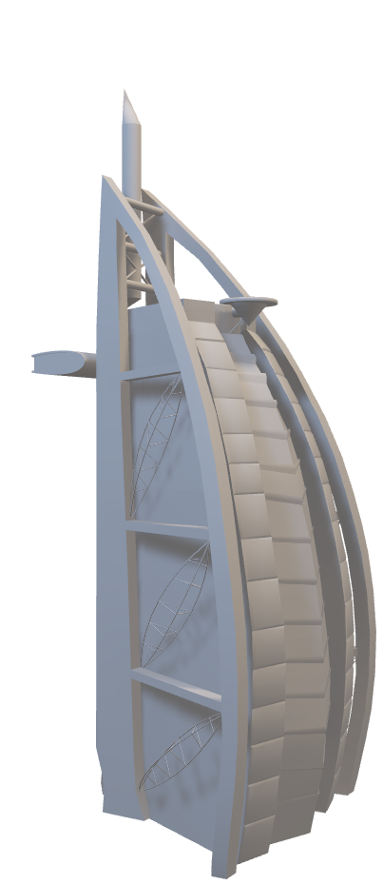
🔍 FINAL INSIGHTS
📌 Business Hotels thrive during weekdays; Luxury Hotels excel during weekends
📌 Presidential rooms under-utilized – marketing campaigns needed
📌 Online platforms have high cancellations – loyalty efforts recommended
📌 Direct bookings provide better margins – push email/SMS remarketing
📌 Weekday to Weekend conversion opportunity using dynamic pricing

Slide 21


📌 Strategic Recommendations
🚀 Launch weekend campaigns for underperforming hotels
📉 Reduce OTA dependency – boost direct booking benefits
📊 Utilize Tableau for geo-targeted offers & season-specific pricing
🧠 Use SQL-based segmentation to identify loyal customers and target upselling
💼 Introduce weekday pricing packages for corporate segments

Slide 22


🔚Conclusion
The Atiq Hotels project provided end-to-end visibility into operational and guest-level metrics. Leveraging Excel, SQL, Power BI, and Tableau enabled data-backed recommendations to enhance booking strategies, reduce cancellations, and increase revenue.

Slide 23
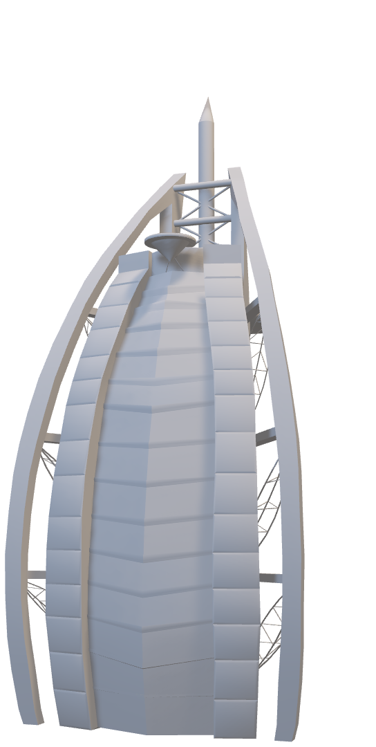
🙏Thank you
Open for questions and discussion

